Slide 1

Embedded Code
PROCESSOR RESET AND BASIC OPERATION

Slide 2

Agenda
Power Point
Learning and Expectations
Dunning-Kruger Effect
10,000 hours
How a processor works
Reset
Registers
Program Counter
Stack Pointer
ATSAMD21 – Memory Map
ARM Assembly Instructions
Thumb
Arm

Slide 3

Power Point
Why the memes?
Power Point sucks to learn anything
So it should be at least entertaining
Keeps me from crying in despair
Only the highlights
Any fool can read a Power Point slide
Do not read slides to audience, use them as highlights for the topic
Helps with Technical data, where you need graphs and drawings.
I Know Nothing,
and I am in front of the class

Slide 4

Learning Takes Time and Practice
How does experience compare to confidence?
So how long will take to get to where you are an expert?

Slide 5

Dunning-Kruger Effect
When you first learn something your confidence grow rapidly, and you think you are an expert.
Imagine a person at each level and what they would say about their abilities. Could you guess where a person is based on what they say?

Slide 6
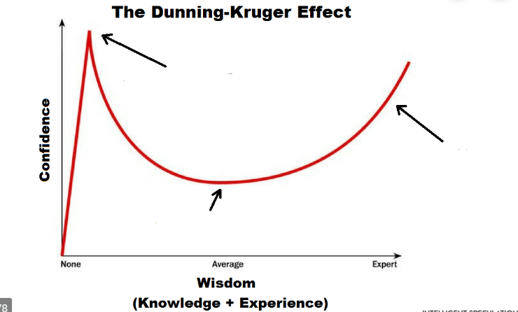
Look at all these stupid
people, I know this already

Slide 7
Look at all these stupid
people, I know this already
Wow! Maybe I don’t know it all!

Slide 8
Look at all these stupid
people, I know this already
How does anything work?
Is it too late to change careers?
Wow! Maybe I don’t know it all!

Slide 9

Dunning-Kruger Effect
A friend told me the following quote:
“There are 30 people in the world that understand ARM’s barrier instructions. There at 15 that work on this floor, only because I pay 40 people on this floor to understand them.”
Where are you on the curve?
Where is the danger zone?
What is the danger zone?

Slide 10

10,000 hours
Enlightenment Slope really takes ~10,000 hours
10,000 hours is 5 years at 40 hours a week.
You will not get everything here the first time through

Slide 11
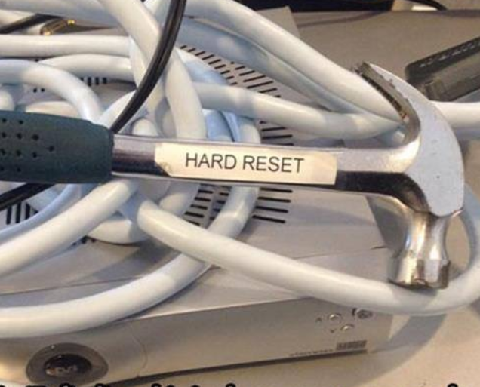
Reset
When an ARM Cortex-M is reset it needs two critical pieces of information
Where to start running code – initial value of the program counter.
Where is the stack, in case an interrupt occurs.
Where does the Program Counter and Stack Pointer live?
Did you check under the table?

Slide 12
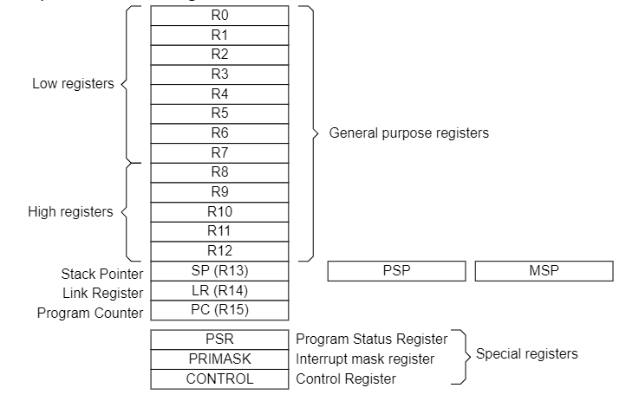
Processor Registers
What are registers?
Really fast 32bit memory locations.
How are they used?
Register File for the M0
Why is it called a register?
Why are they called a file?
If it is a file what extension does it have .txt?

Slide 13
Program Counter
Keeps track of the next instruction to execute.
It is complicated, so let’s watch Youtube
https://www.youtube.com/watch?v=ccf9ngGIb8c
We will see the program counter in action soon…

Slide 14
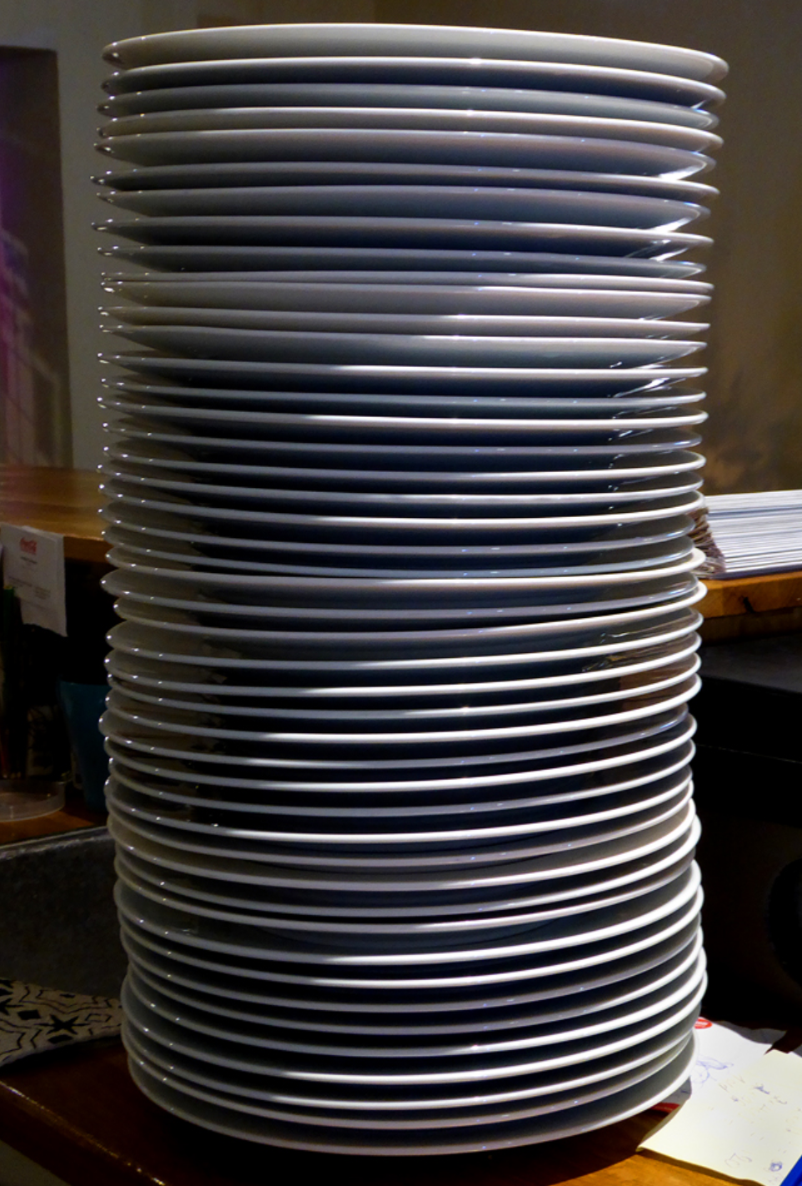
Stack Pointer
You thought the program counter was complicated….
Stack is like a stack of plates you can push a stack on the top or pop off the top.

Slide 15
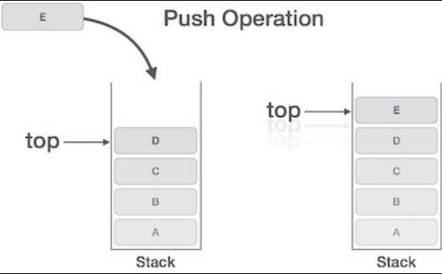
Stack Pointer
On a computer it is use for a way to store data into memory.
The Stack Pointer always points the top of the stack
A stack is a key part of C compiler…

Slide 16
Stack Pointer
0x0100C
On the Cortex-Mx processor the stack grows down…
High memory address to low memory address
SP starts at 0x100C
Push 0x0E to stack
SP decrements to 0x1008
Grows down…
0x01000
SP
0x100C
0x0100C
0x0E
0x01000
0x1008
SP

Slide 17
Why have a Stack Pointer?
It is complicated, of course…
C programming language is based on the use of a stack
One reason the original PIC processors sucked, they had no stack pointer
When functions are called, information is pushed on stack
When functions return, data is restored from stack
ARM decided to help C be faster and made hardware to push data on stack automatically when interrupts/exceptions are called.
Since an interrupt may be called right after reset, the processor core needs a stack before we can start running code.
We will go into more detail about stack when we discuss C programming and function calls.

Slide 18
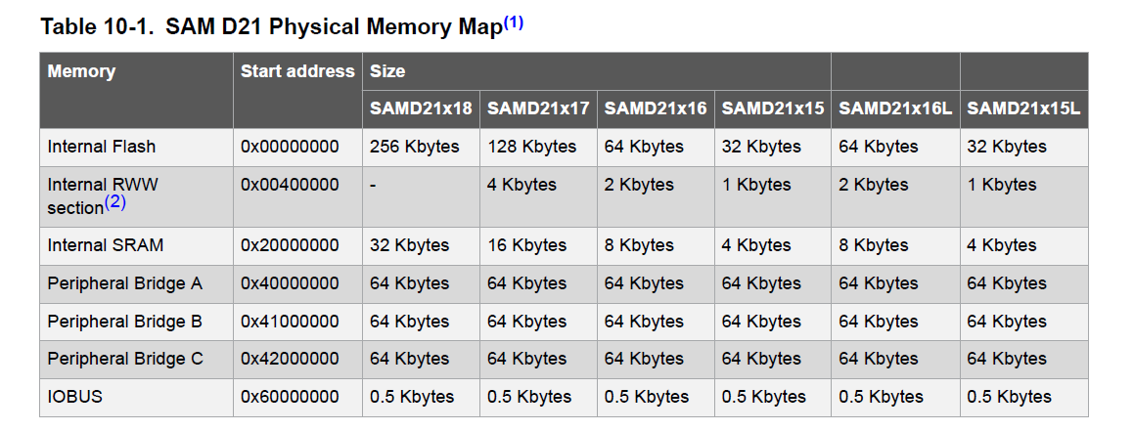
ATSAMD21 Memory Map

Slide 19
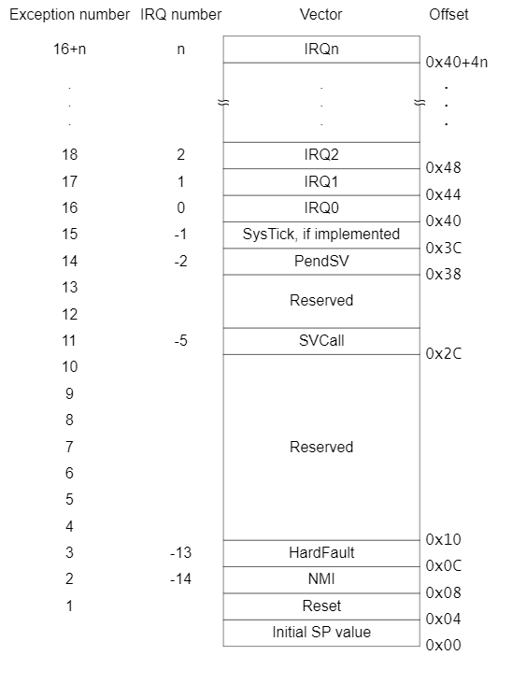
Cortex-Mo Vector Table
Address 0x0000 -> Initial Stack Pointer
Address 0x0004 -> Reset

Slide 20
ATSAMD21 Vectors
The SAMD21 has 30 additional exception vectors
These are used for peripheral interrupts
The Vector table is stored at address 0x0000_0000 in flash.
The Cortex M0 does not allow changing the vector table location.
The Cortex M0+,M3,M4,M7… does through the VTOR register.
Vector Table Offset Register

Slide 21
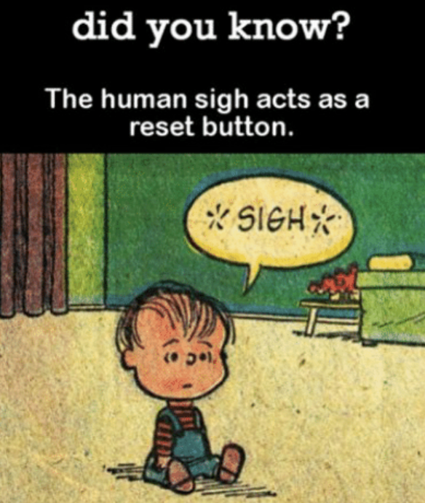
Reset Operations
Load the Stack Pointer (SP) from address 0x0000
Load the Program Counter (PC) from address 0x0004
Fetch instruction from PC
Execute instruction
Increment PC
Go to step #3
SIGH – Nope did not work

Slide 22
ARM Instructions
ARM has two type of instructions:
ARM instructions – 32bit width
Thumb instructions - 16bit width
Why do you think it would be nice to have both?
The Cortex M0 can run mixture of both, or run just one
How does the core know if you are using thumb or ARM instructions?

Slide 23
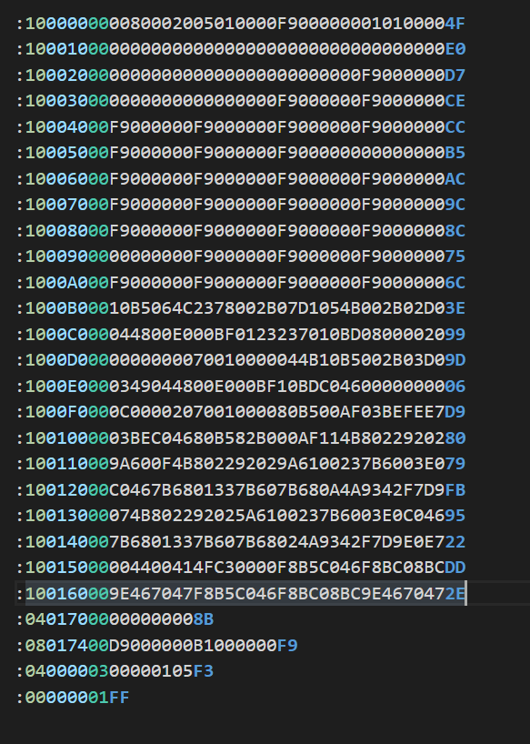
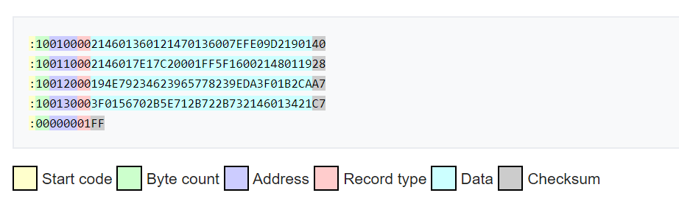
File Types – Intel Hex
https://en.wikipedia.org/wiki/Intel_HEX

Slide 24
Binary Files
The binary data with no CRC or address information.
Use a “Hex Editor” to read binary files.

Slide 25
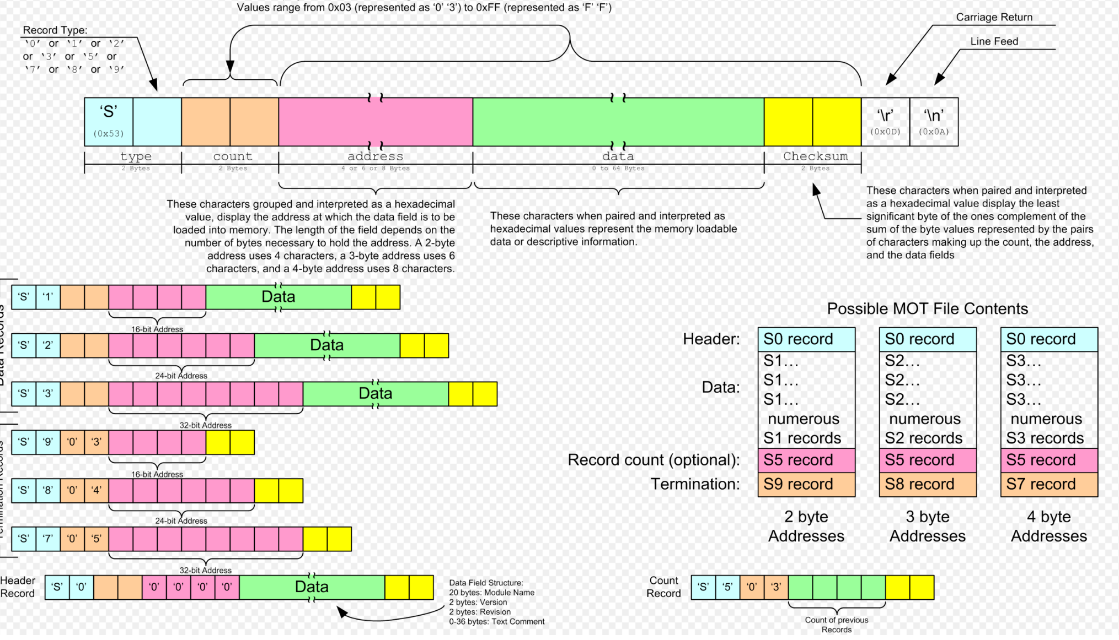
S-Record
Intel made the “Intel Hex” format…
Motorola made “S-Record”
https://en.wikipedia.org/wiki/SREC_(file_format)
Note used much any more

Slide 26
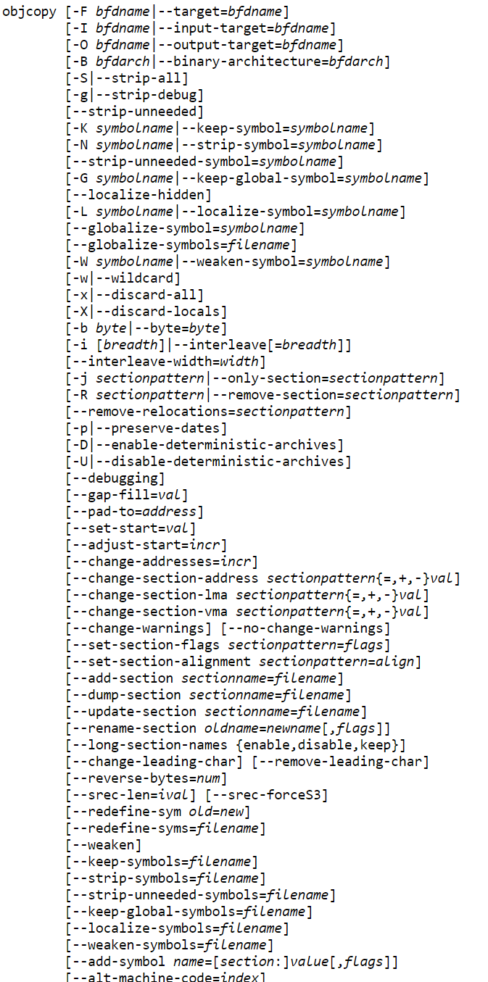
Objcopy
Object Copy is a utility that comes with GCC
Will translate file formats (intel, binary, s-record)
The options are almost endless
We will see how this is used latter, when we program a C program
For now just know it will create files for you
See C:\Program Files (x86)\GNU Tools ARM Embedded\8 2019-q3-update\bin

Slide 27
JFlashLite
Segger JFlashLite is a program you can use to program your board.
Accepts most all file formats (hex, binary, s-record)
C:\Program Files (x86)\SEGGER\JLink

Slide 28
Example
Let’s Look a very simple program to blink LED on our board.
Goal:
Power up and blink the Red LED
Demonstrate reset vector and stack pointer in vector table
Show the disassembly of the code.
Where did the Stack Pointer initial value come from?

Slide 29
Homework
Use Segger’s JFlash tools to upload the Intel Hex for the example project to your board.
Make sure the LED Blinks.
Copy example code to your laptop and see if you can compile and setup debugger in Eclipse. You most likely will need help so ask when ready.
Using the assembly code and O-scope calculate the clock rate of the microprocessor.
Determine how the example code knew where to put the vector table.

Slide 30
Next Class
Linker File and Sections
How the C compiler works (roughly)
Introduction to C
Stack Pointer
ABI
Interrupts
A simple start up and main() function that blinks LED

